Slide 1
Corporate Finance
First Look at Investments: Historical Returns
Fall 2025
Prof. Jeffrey Colón

Slide 2
Risk and Return: Overview
Historical US and global returns and volatility
How to estimate and measure risk and return
Single assets
Portfolio of assets
Role of Risk aversion
Examine sample asset returns and variances
Portfolios and diversification
How to measure the benefits of diversification
How to measure the trade-off between risk and return
Construction of diverse portfolios
Limits
Importance: Determine the Cost of Capital →

Slide 3
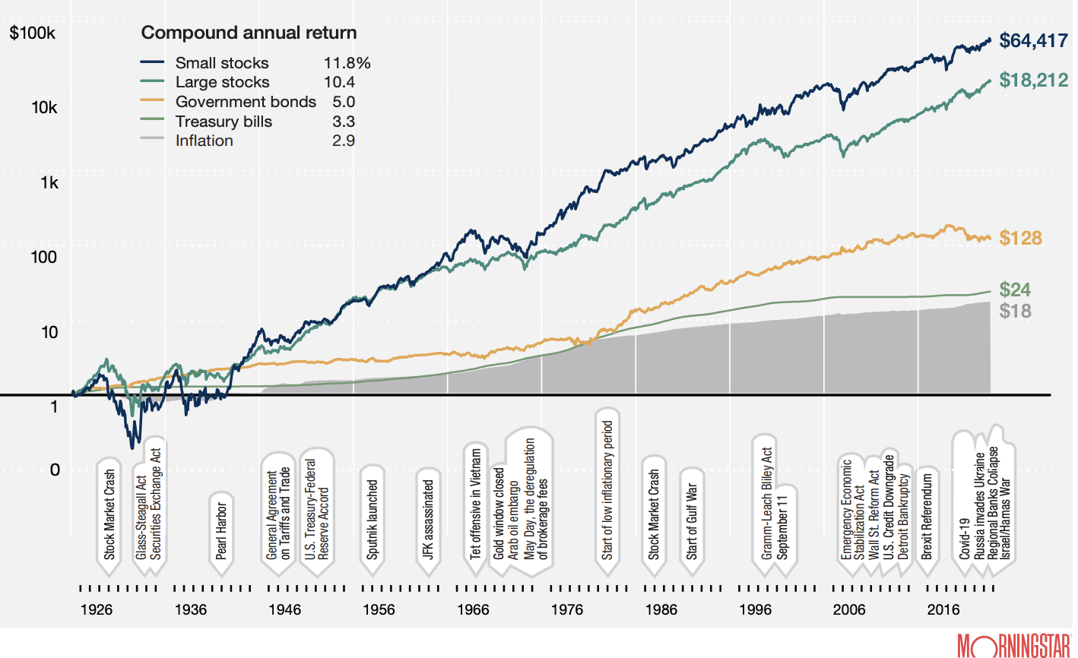
Nominal Value of an Investment of $1 in 1926 Through 2024 (U.S.)

Slide 4
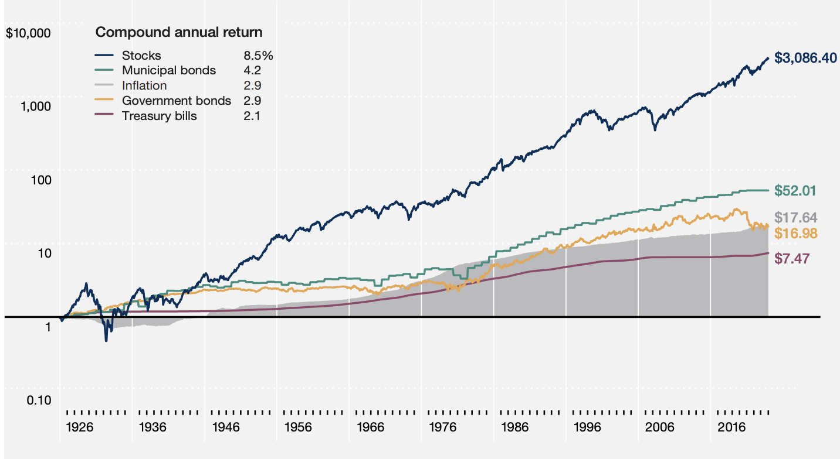
Value of an Investment of $1 (after taxes) in 1926 Through 2024 (U.S.)

Slide 5
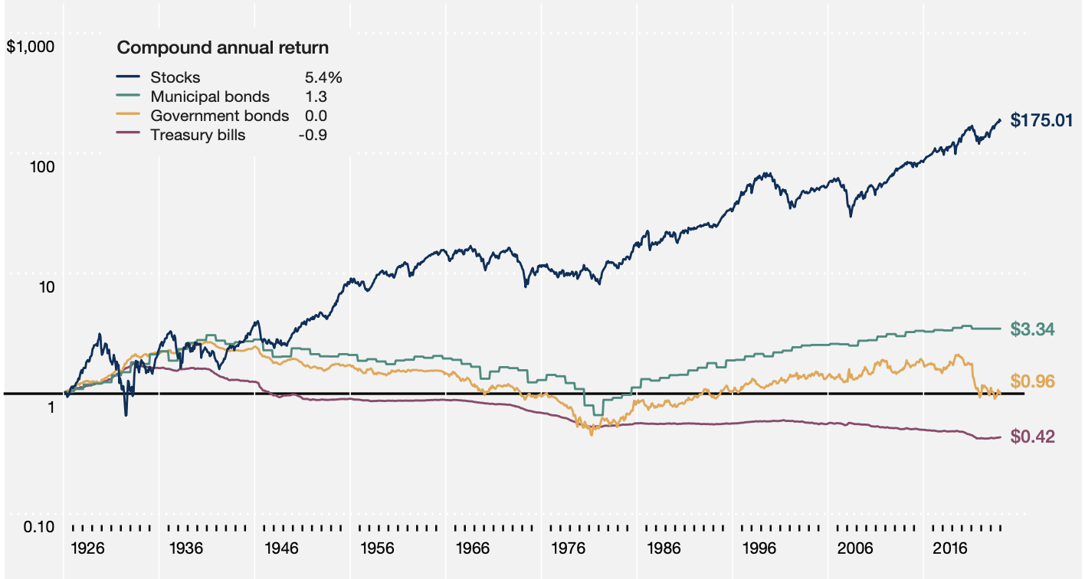
Real (after inflation & taxes) Value of an Investment of $1 in 1926 Through 2024 (U.S.)

Slide 6
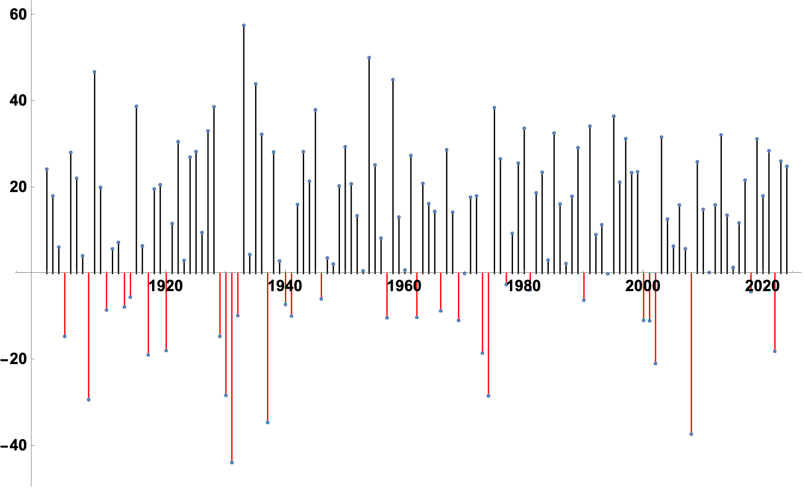
Time Series: US Stock Returns (1900-2024)

Slide 7
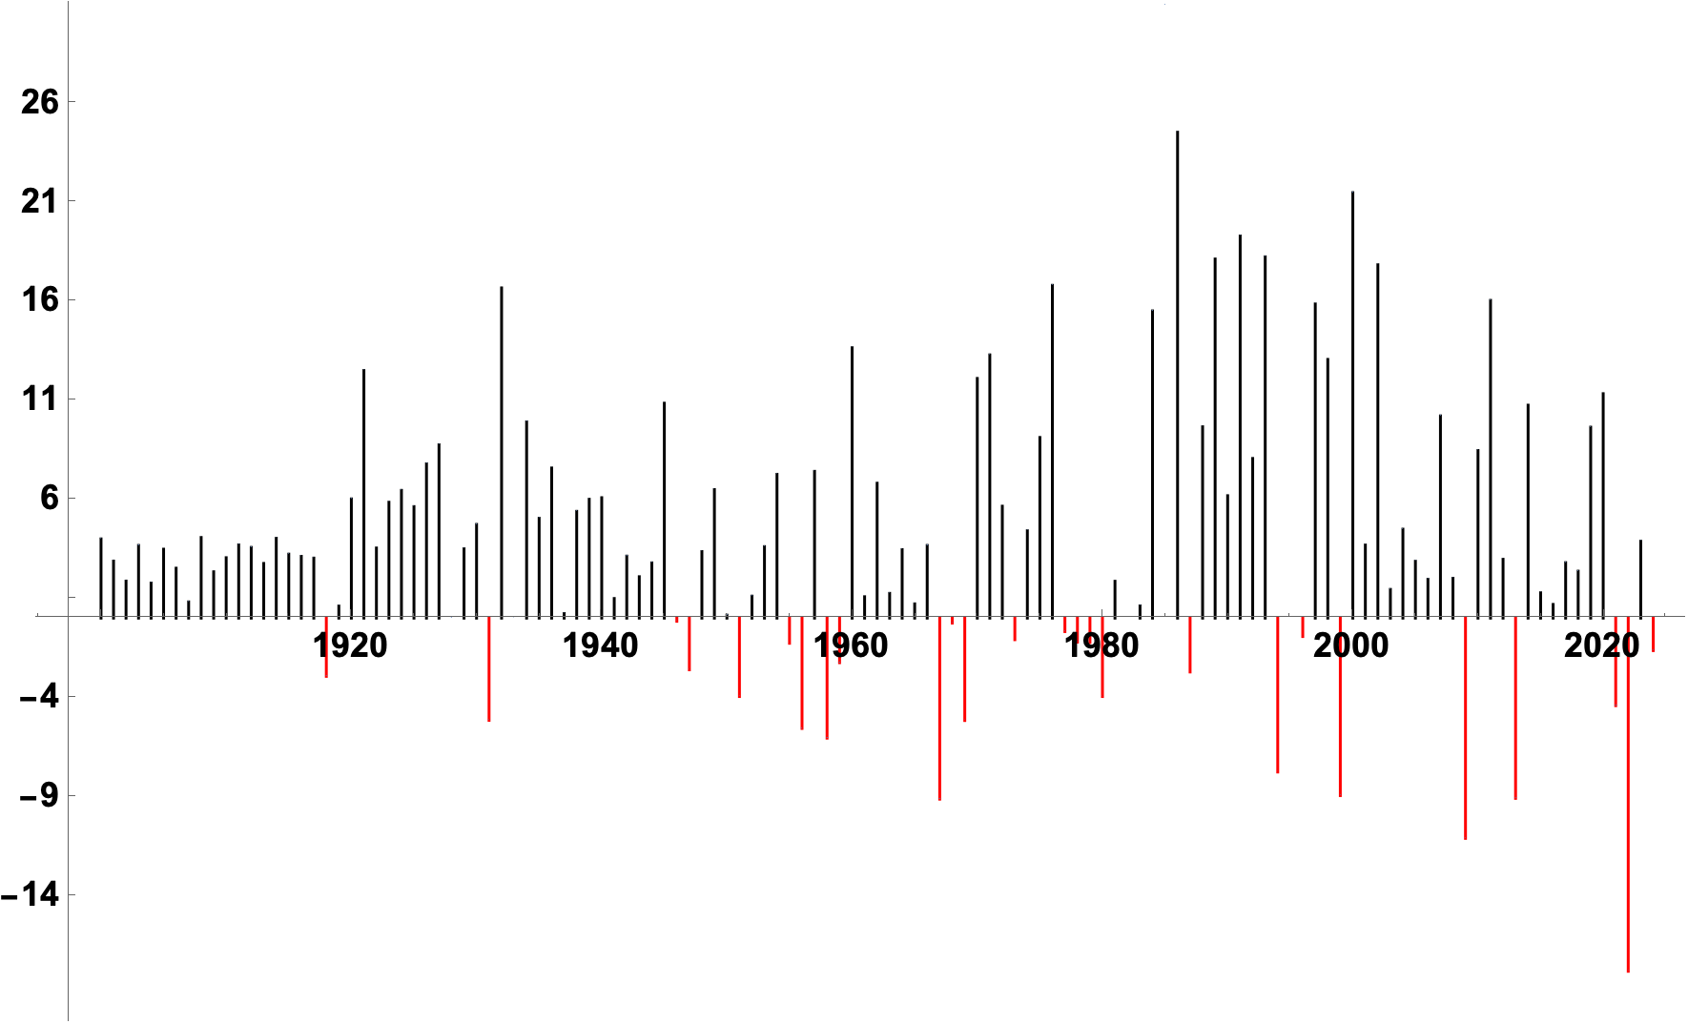
Time Series: US Bond (10-yr) Returns (1900-2024)

Slide 8
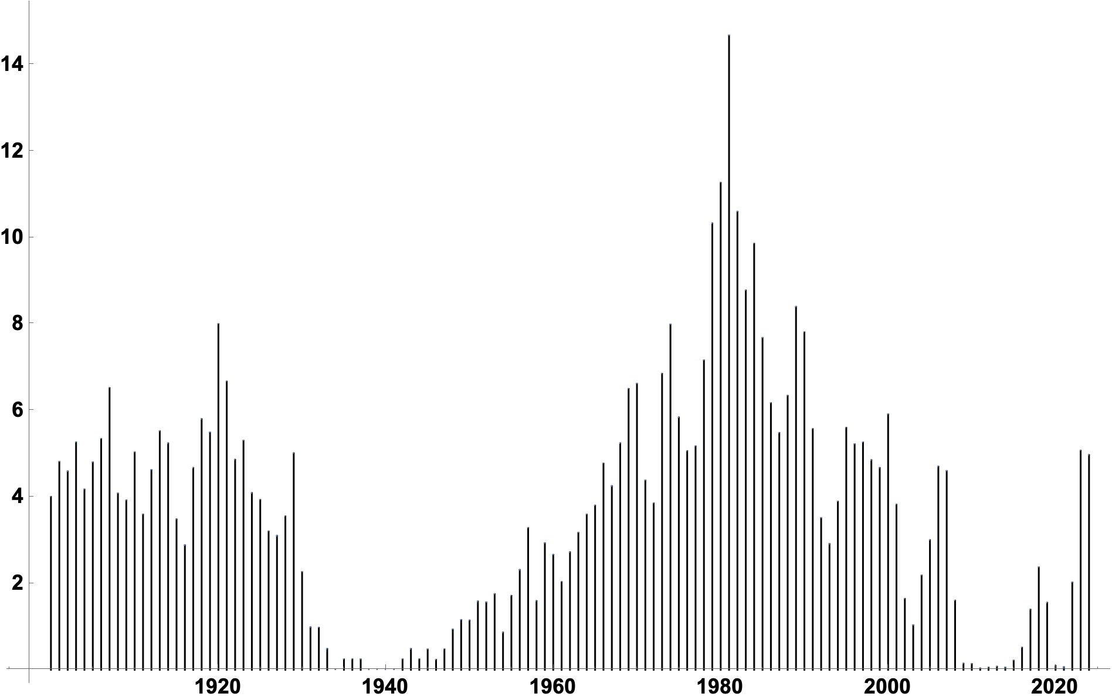
Time Series: T-Bill Returns (1900-2024)

Slide 9
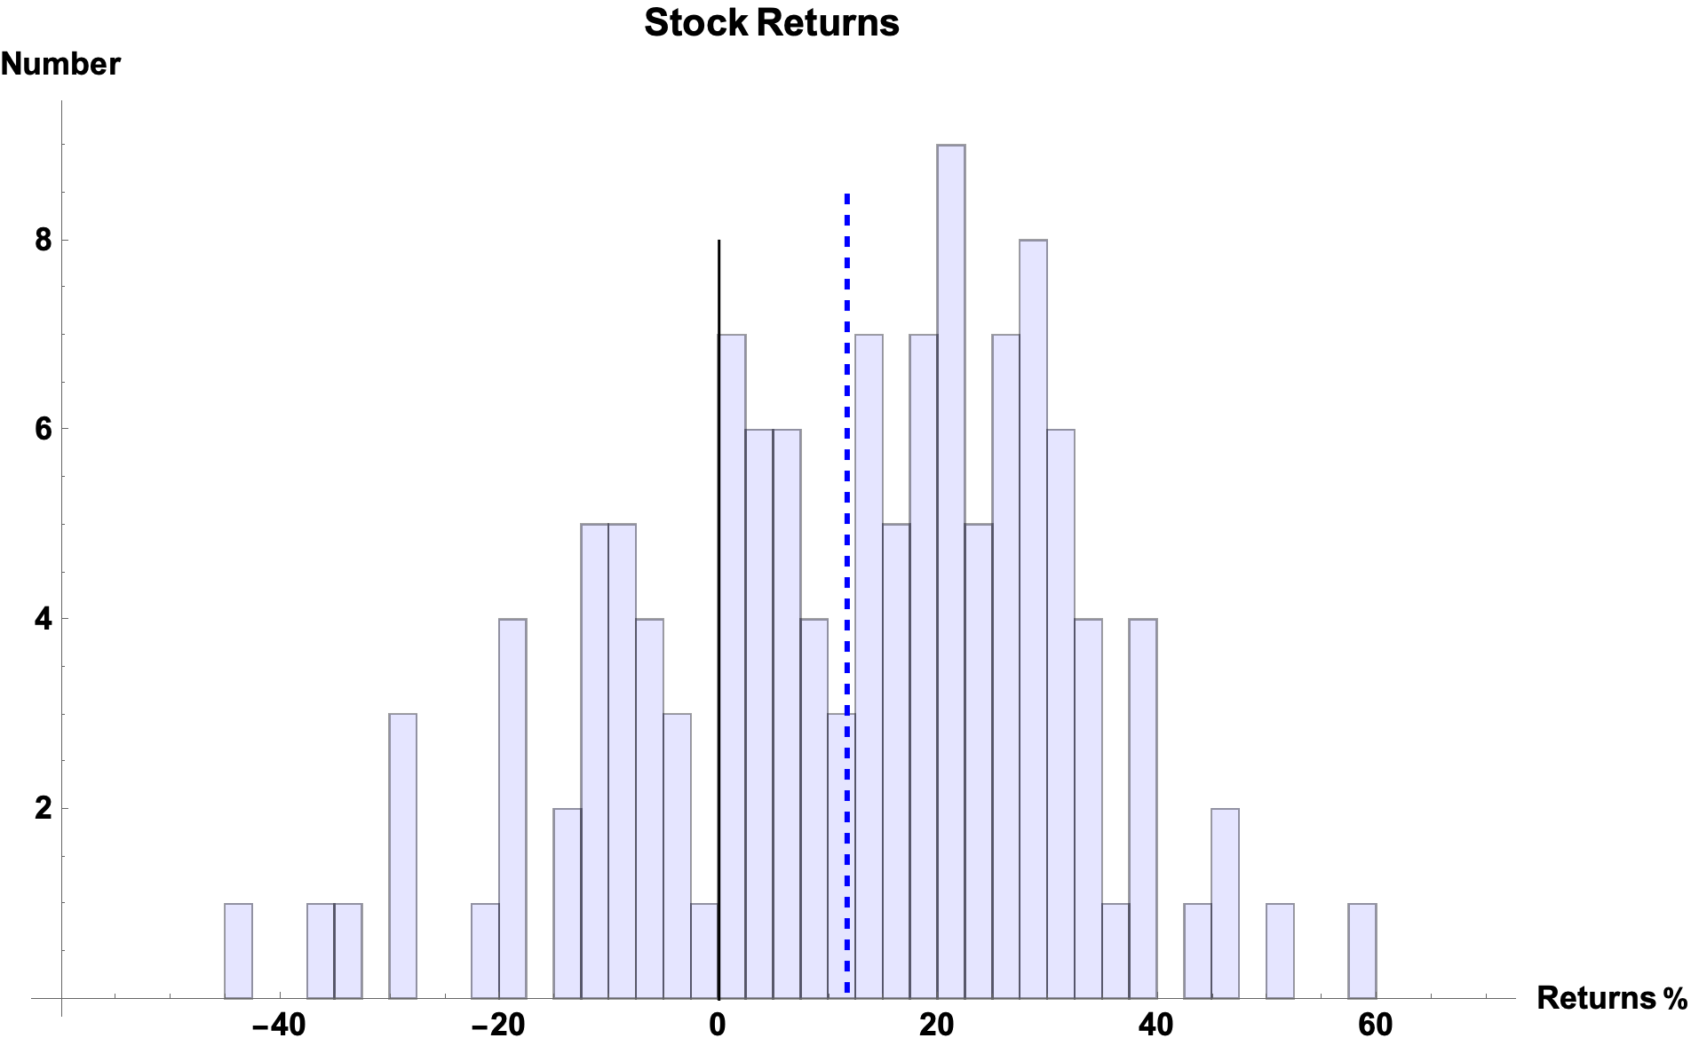
Histogram: US Stock Returns (1900-2024)
Mean: 11.68%

Slide 10
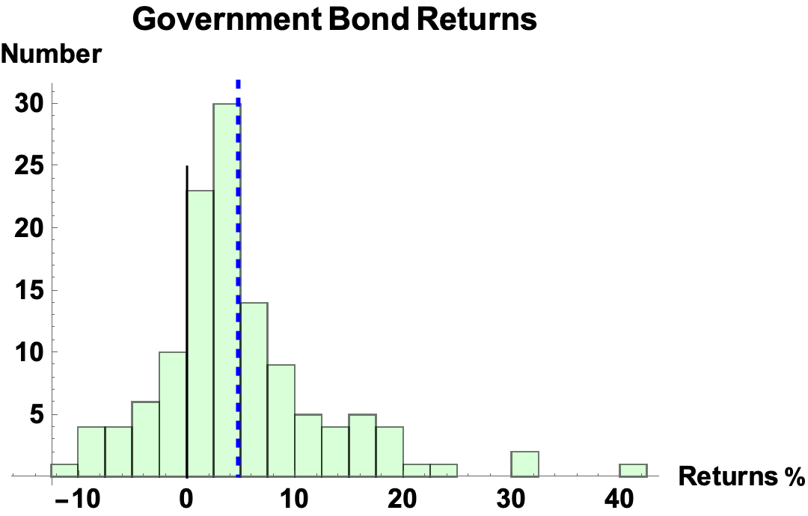
Histogram: US 10-YR Bond Returns (1900-2024)
Mean: 4.72%

Slide 11
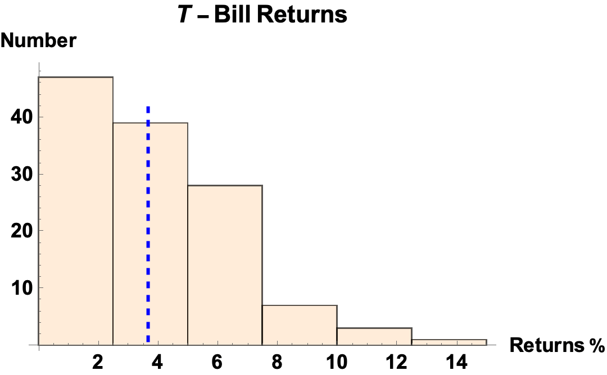
Histogram: T-Bill Return (1900-2024)
Mean: 3.66%

Slide 12
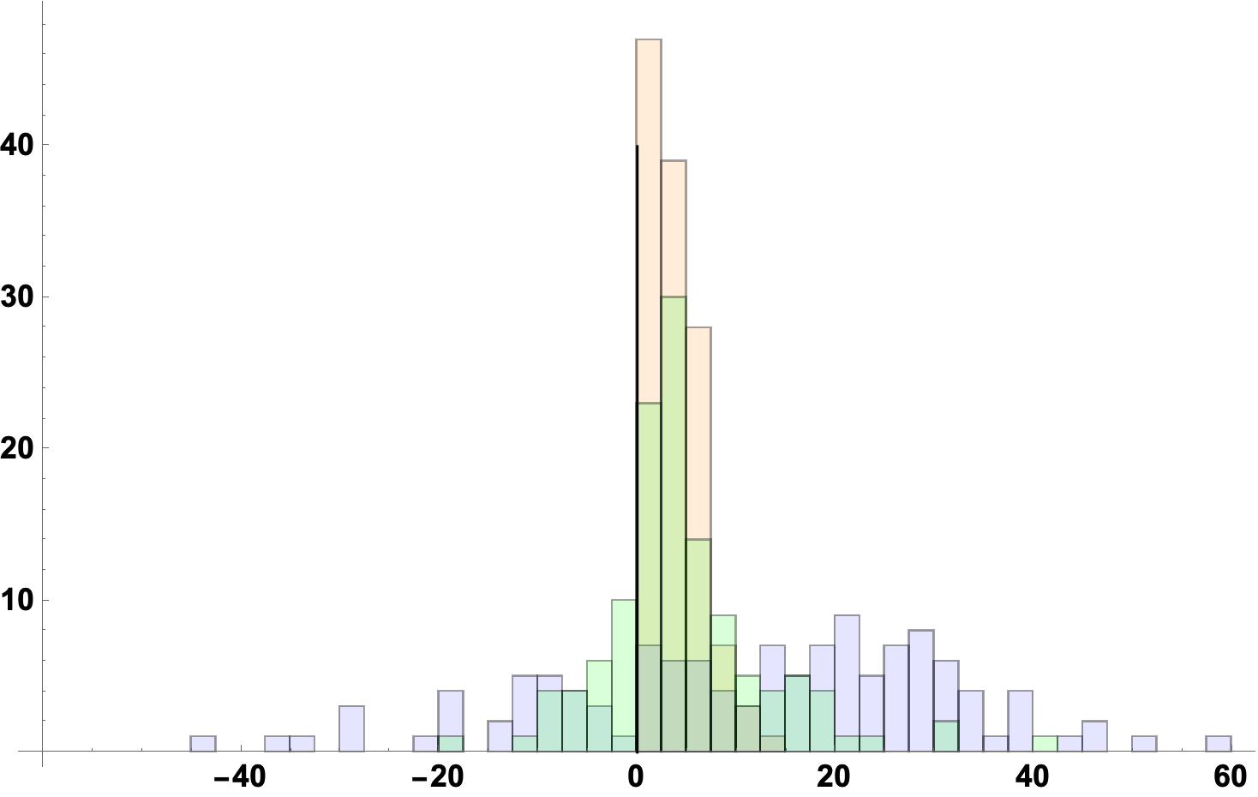
Histogram: Returns of US Stocks, Bonds, and T-Bills (1900-2024)
T-Bills
Bonds
Stocks

Slide 13
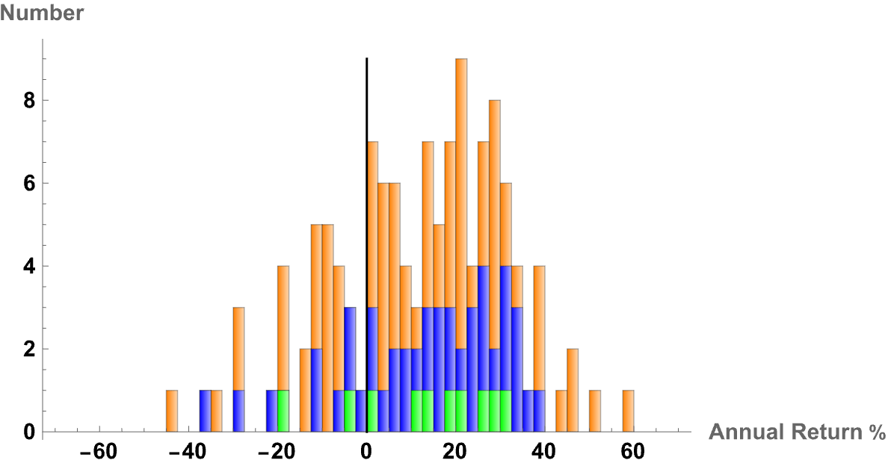
U.S. Equity Nominal Returns
1900-2024 (Mean = 11.68%)
1975-2024 (Mean = 13.81%)
2015-2024 (Mean = 14.11%)
1900-2024 (Mean = 11.68%)
1975-2024 (Mean = 13.81%)
2015-2024 (Mean = 14.11%)

Slide 14
Annual Nominal Returns: SP500, T-Bills, T-Bonds
 |  | SP500 | T-Bills | T-Bonds | Baa Corp Bond
 |  |  | Arithmetic
1928-2024 |  | 11.79% | 3.36% | 4.79% | 6.90%
1975-2024 |  | 13.55% | 4.30% | 6.52% | 8.94%
2015-2024 |  | 14.11% | 1.78% | 0.57% | 3.81%
 |  |  | Geometric
1928-2024 |  | 9.94% | 3.31% | 4.50% | 6.62%
1974-2024 |  | 12.26% | 4.25% | 6.05% | 8.62%
2014-2024 |  | 12.98% | 1.76% | 0.27% | 3.44%
2001-2010 |  | 1.38% | 2.16% | 5.49%
Source: Damodaran

Slide 15
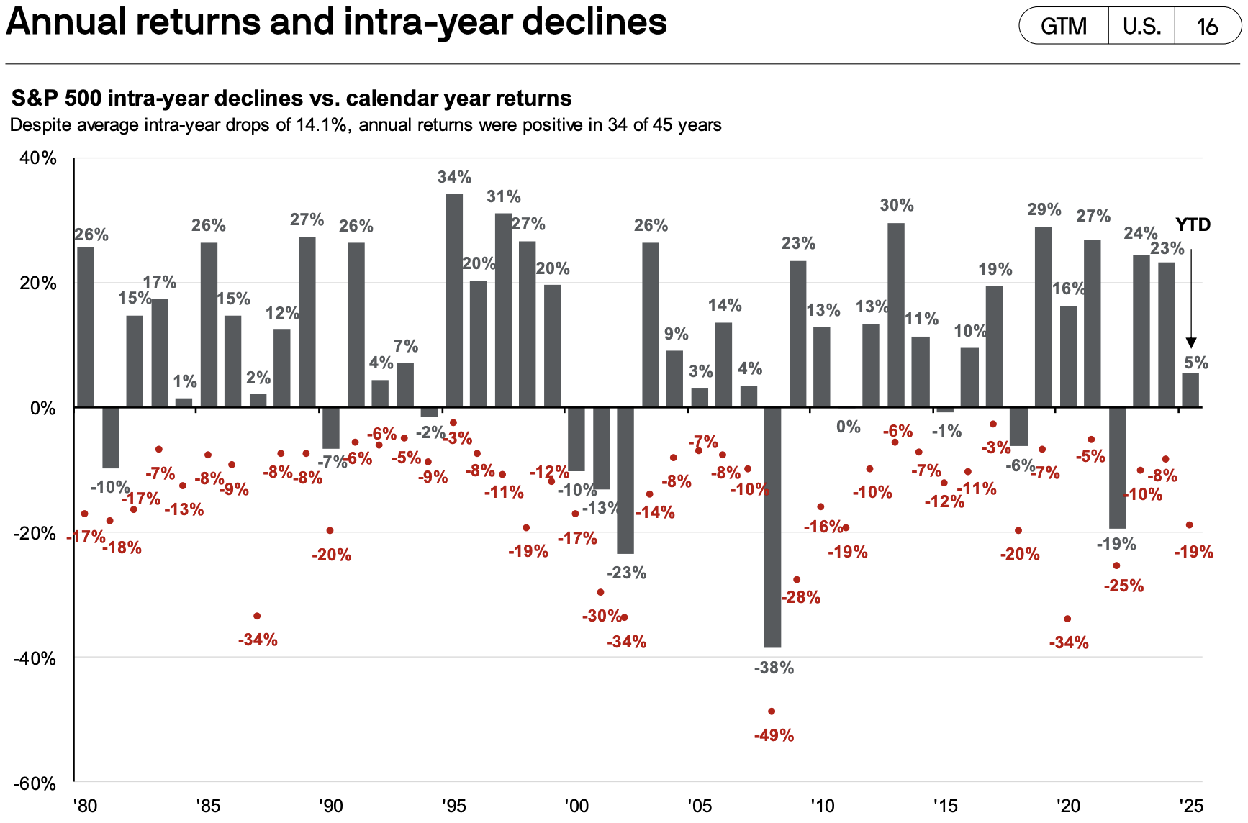
The Ride Can be Rough (1980 - 2025 3Q)

Slide 16
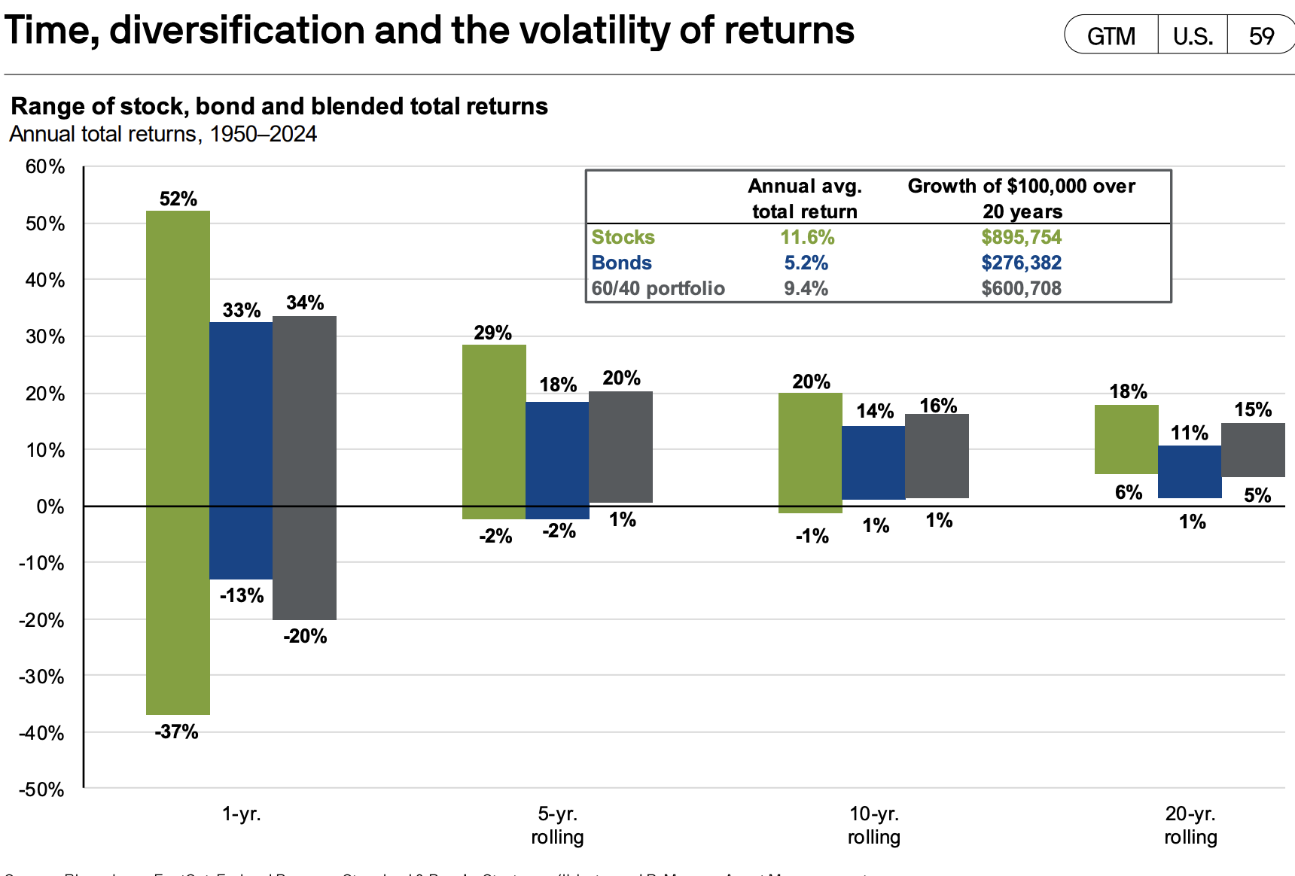
Reduction of Risk Over Time: 1950-2024
Source: JPM GTM

Slide 17
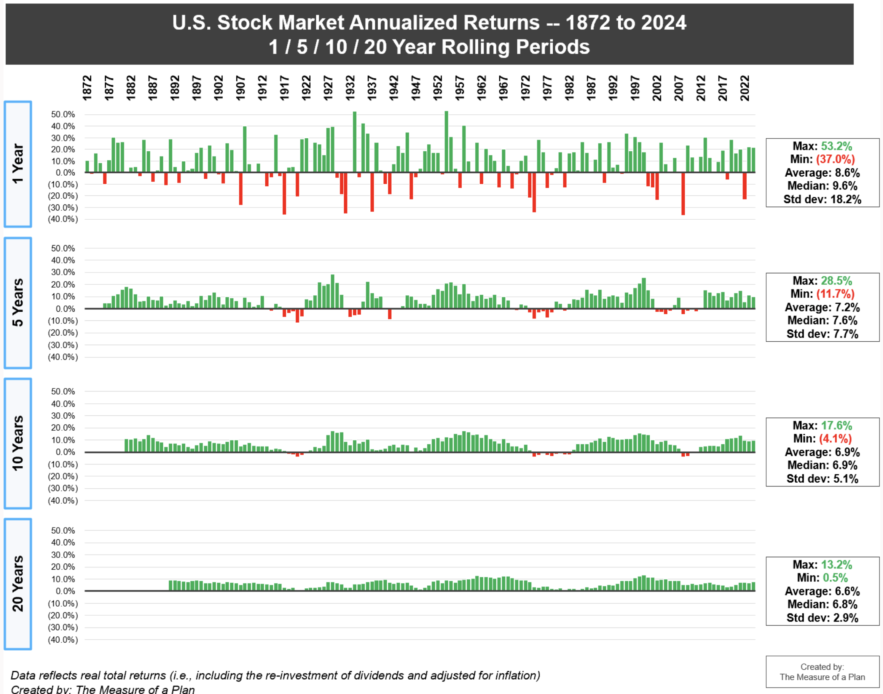
US Stock Market Total Returns: Rolling Periods (1872 – 2024)

Slide 18
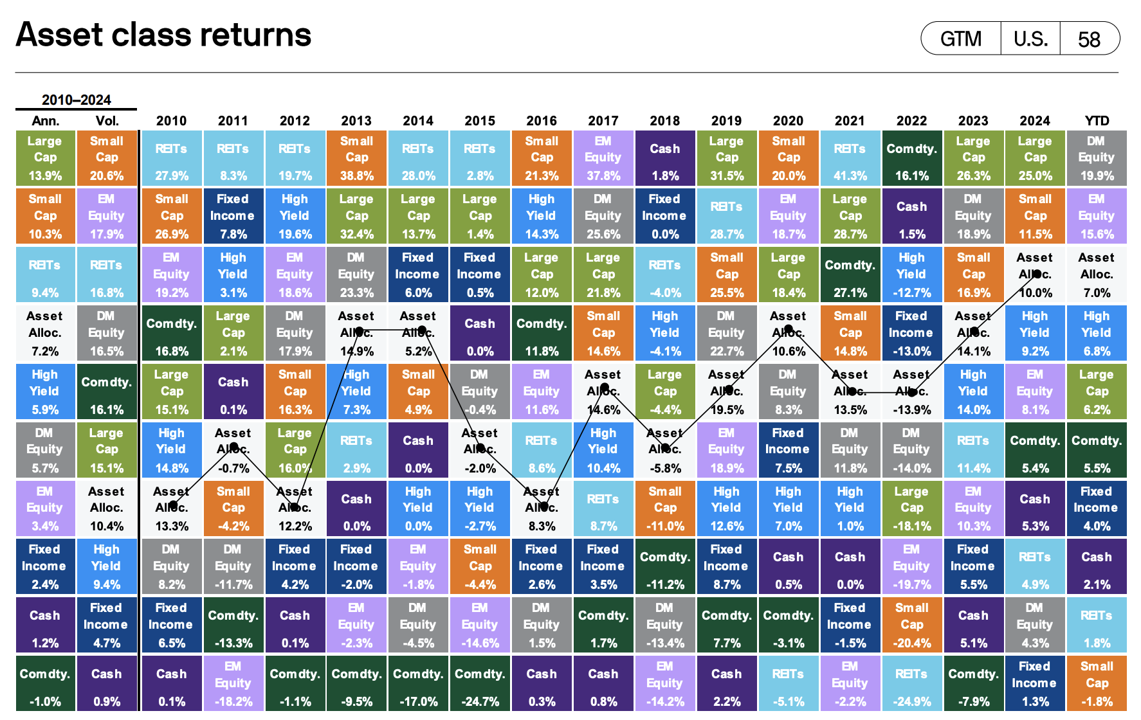
Asset-Class Winners & Losers: 2010 – 2025 (3rdQ)
Source: JP Morgan GTM

Slide 19
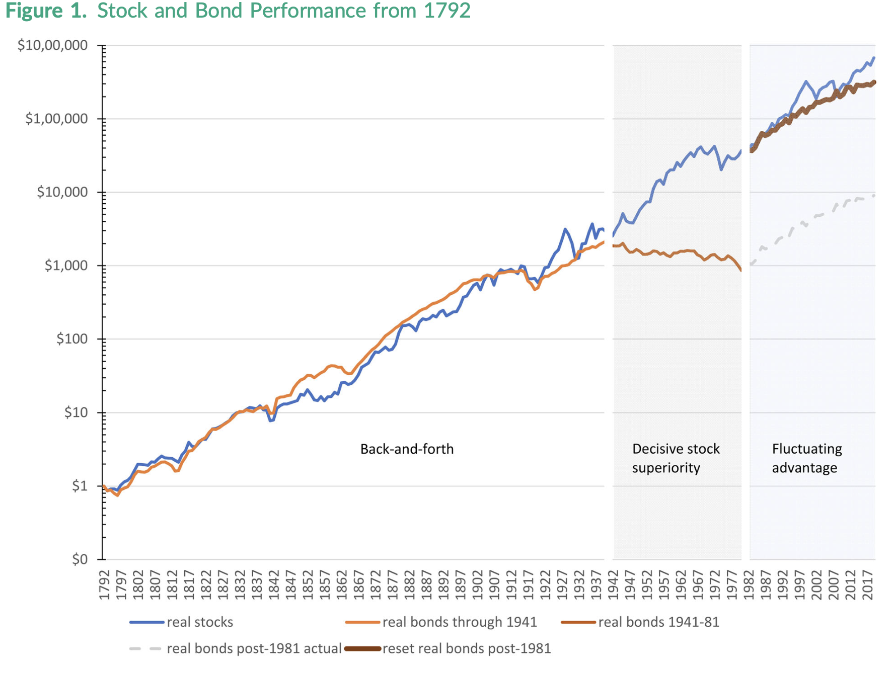
Stocks beat bonds, but not always
McQuarrie Stocks for the Long Run? Sometimes Yes, Sometimes No (2023)

Slide 20
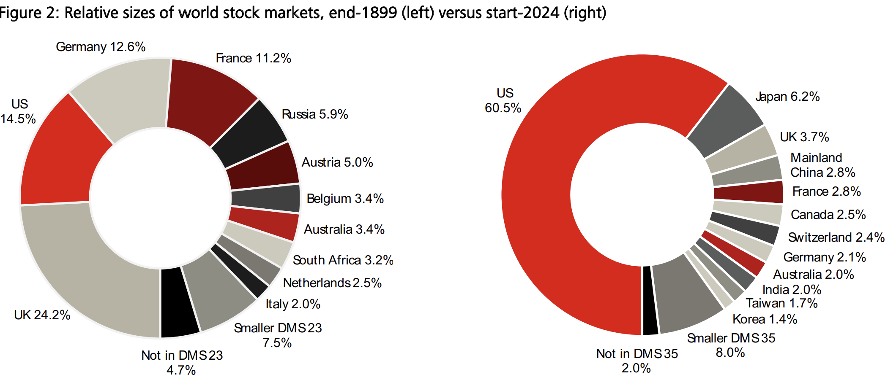
World Stock Markets: 1899 vs. 2024

Slide 21
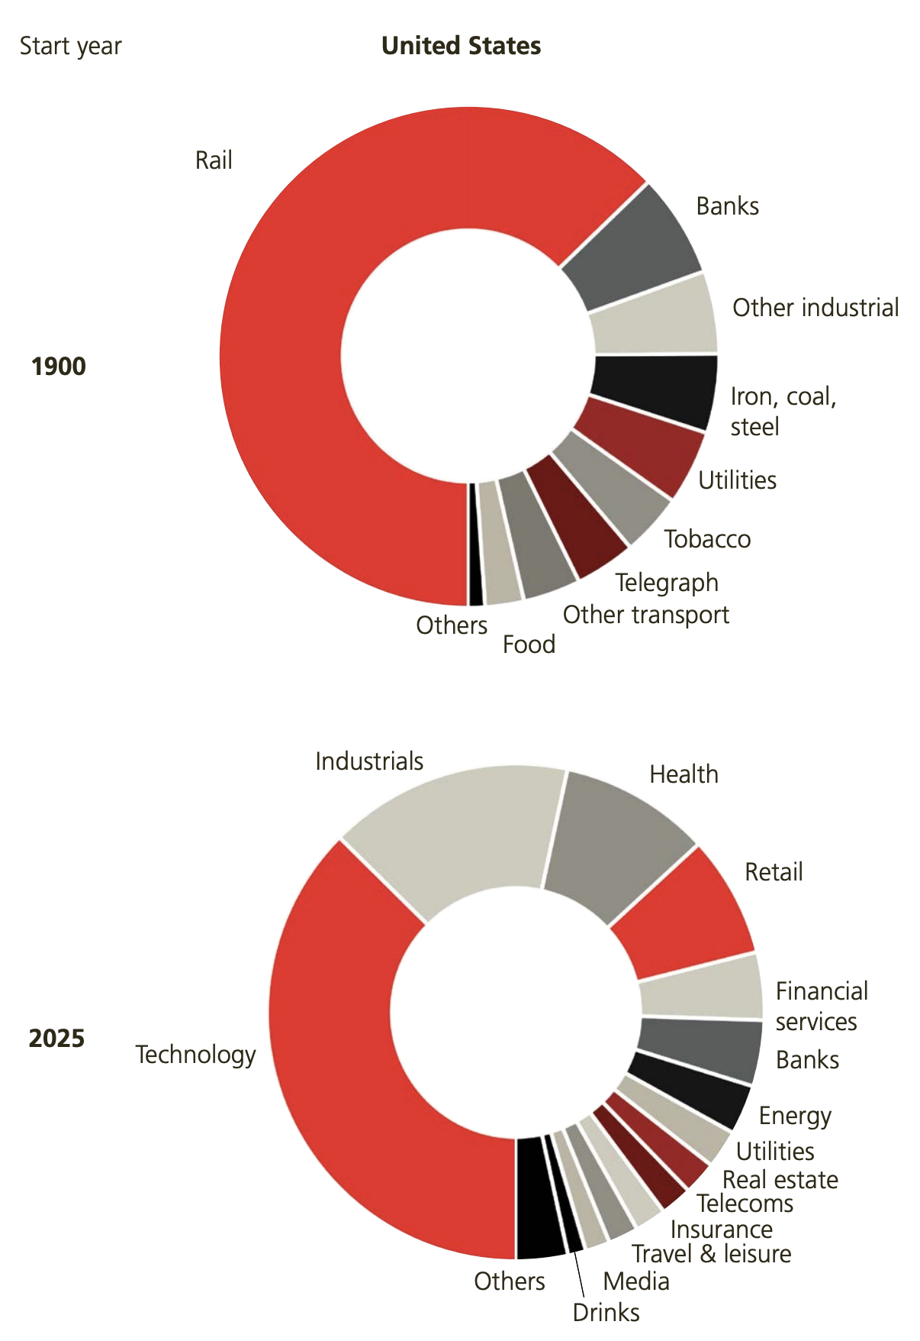
Industry Weighting in the US: 1900 and 2025
Source: Credit Swiss Global Invest. Returns YB 2021

Slide 22
A Step Back
Stocks had higher returns than bonds, which beat cash
Cash was the safest investment, followed by bonds and stocks.
Portfolios generally have less than risk than individual stocks
Average return is always greater than geometric return
Correlation between stock market and cash/bond is low (10%), but around 50% -70% for individual stocks and the market.
Historical risk measures (correlation, Sdev, Beta) are more stable than historical returns

Slide 23
Returns: Single Asset
Return of asset “j” at time t=
Sample Average Return
(Arithmetic Mean):
Sample Average Return
(Geometric Mean):

Slide 24
Measuring Risk (Volatility): Single Asset
Variance:
Standard Deviation:
Example
A stock has the following returns (in %): 8, -10, 24, 5, and -2. Find the mean and SD of the returns.
Mean: (8-10+24+5-2) / 5 = 5%
Var: 1/5*[(8-5)²+(-10-5)²+(24-5)²+(5-5)²+(-2-5)²] = 128.8%²
SD: √Var = 11.35%

Slide 25
Risk and Risk Aversion
As investors, for wealth we don’t consume today, we aim generally to maximize expected future consumption or maximize expected future utility of wealth
We generally prefer more to less, and
Our utility increases as wealth increases, but at a decreasing rate
Different representations of utility curves:
Logarithm
Square Root

Slide 26
Risk Lover, Risk Averse, and Risk Neutral
Risk Averse:
rejects fair bets;
pays premium (more than expected value) for insurance
Risk Neutral:
is indifferent about fair bets;
does not pay a premium for insurance
Risk Lover:
accepts all fair (and some unfair) bets;
never purchases insurance

Slide 27
Diversification
What happens to expected returns when assets are combined to form portfolios?
E(wAMZN + wBABA + wTBill) ?=? wE(AMZN) +wE(BABA) + wE(TBill)
What happens to risk (standard deviation) when assets are combined to form portfolios?
SD(wAMZN + wBABA + wTBill) ?=? wSD(AMZN) + wSD(BABA) + wSD(TBill)
Efficient Portfolio: portfolio whose return is maximized for a given level of risk or whose risk is minimized for a given level of return

Slide 28
Diversification
Diversification can lower an investor’s overall risk to the extent that the returns of the assets in a portfolio don’t move together.
Measures of comovement: correlation, covariance, and beta (β)
The market beta (β) of a stock measures a stock’s comovement with the market portfolio
A stock with a negative beta functions like insurance

Slide 29
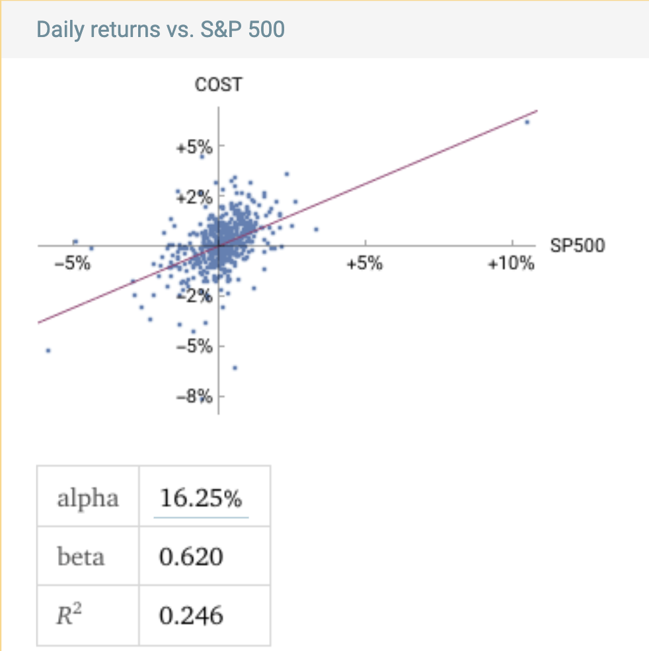
Beta (β) of COST-SP500 (Sept 2025, past 2 years)

Slide 30
Public Investment Companies
Investment Companies
Open-end Mutual Funds
Exchange Traded Funds (ETFs)
Closed-end Funds
Regulation
Investment Company Act of 1940
Investment Advisers Act of 1940

Slide 31

Open-End Mutual Fund
Buy
Sell
$$ @ NAV
$$ @ NAV
Mutual Fund Regulated Invest. Co.
Assets: Stocks, Bonds, RE
NAV: Net Assets (Ass-Liab) / # Shares

Slide 32
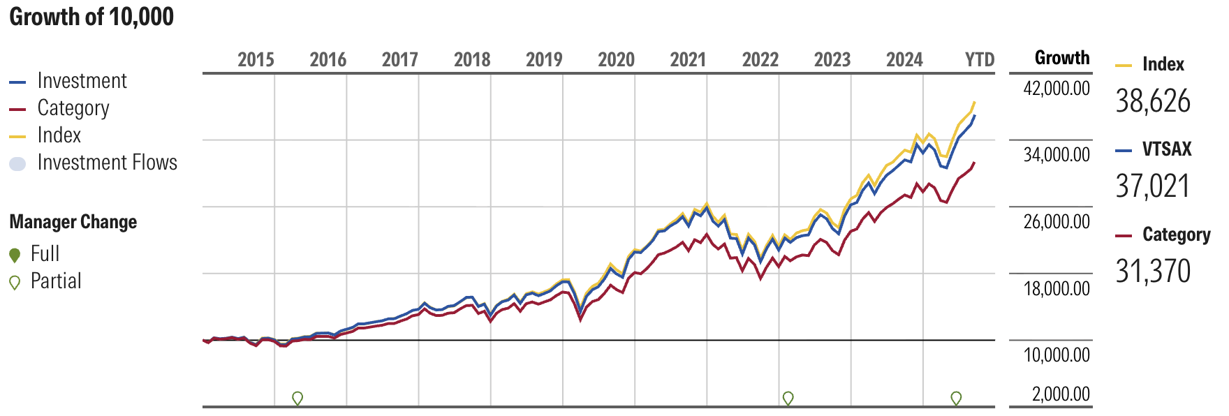
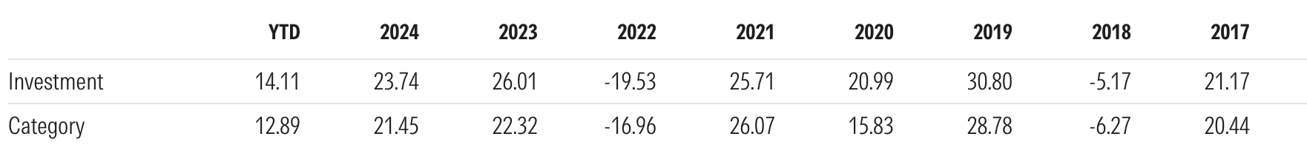
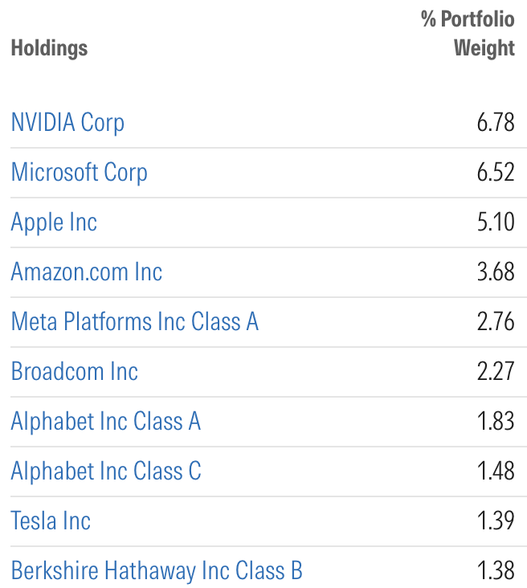
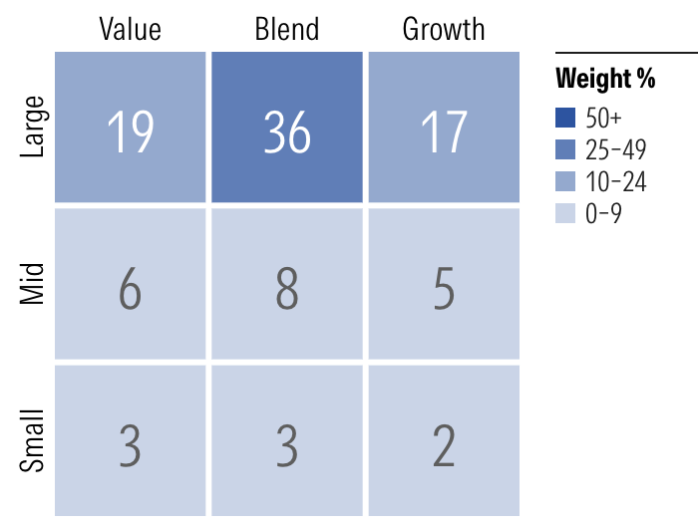
Open-End Mutual Fund: VTSAX

Slide 33
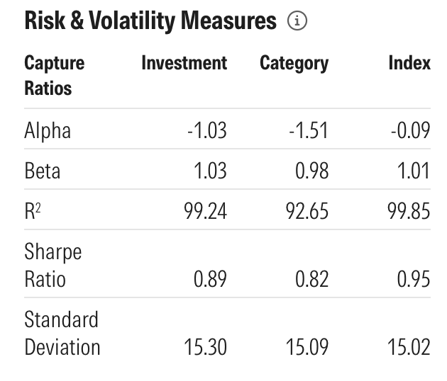
Open-End Mutual Fund: VTSAX

Slide 34
Exchanged Traded Funds (ETFs)
Sale/purchase of
ETF shares @ market price
Authorized Participant
Buy Shares
Redeem Shares
Contribute
portfolio
Portfolio (not $)
ETF Regulated Invest. Co.
Creation/Redemption
If NAV (10) > mrkt price (9)
Buy shares at 9, redeem, and sell portfolio for 10
If NAV (9) < mrkt price (10)
Buy portfolio at 9, create shares, and sell to public for 10
Assets: Stocks, Bonds, RE

Slide 35



Shorting
I believe that Apple stock is overvalued. How can I make money if my beliefs are correct?
Borrow shares
Sell shares
Receive $$$
IOU: Return shares + Dividends
Return shares
Buy shares
Cancel IOU
$$$

Slide 36
Employee Retirement Income Security Act (ERISA, 1974)
Defined benefit (DB) vs. Defined contribution (DC) plans
Fiduciary duties apply to apply to plan trustees, administrators, and investment committee
Duty to act prudently—importance of process
Investment selection & continuing monitoring
Duty to diversify plan assets
Exception for participant-directed plans (401(k)) and Qualified Default Investment Alternative (QDIA)
Duty to pay only reasonable plan expenses
Personal liability for breaches of fiduciary duty
Excessive fee litigation
Recordkeeping fees (% of AUM or fixed fee per capita)
Fund fees (retail vs. institutional classes)
Confusing menu choices (brokerage windows)
Hughes v. Northwestern

